Slide 1

SOLELY FOR PURPOSES OF FORAGE WORK EXPERIENCE
Sentiment Analysis of British Airways Customer Reviews

Slide 2
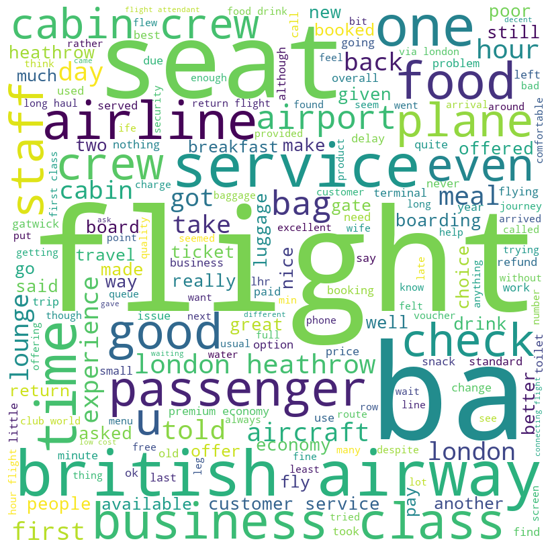
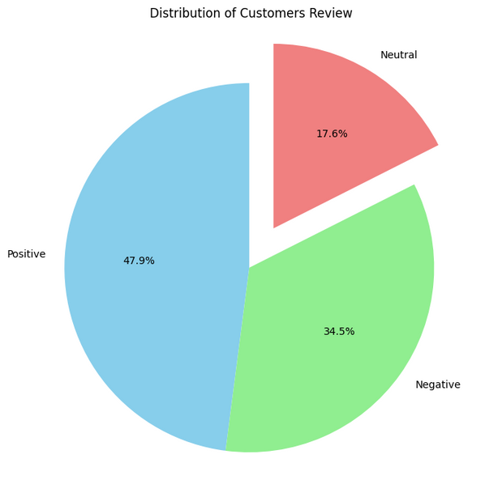
SOLELY FOR PURPOSES OF FORAGE WORK EXPERIENCE
Insights From Customers Reviews
WordCloud of Review Sentiments
Customer Review breakdown
Positive Reviews: 958
Neutral Reviews: 691
Negative Reviews:

Slide 3
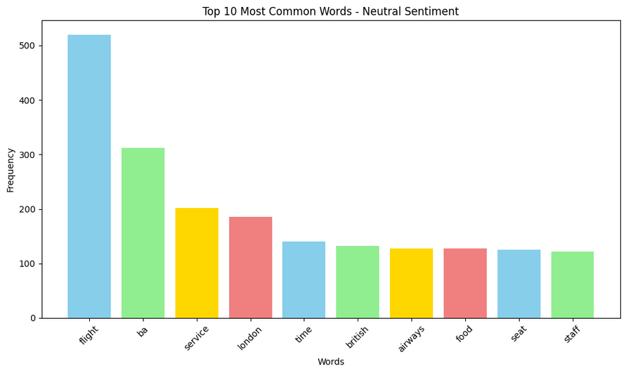
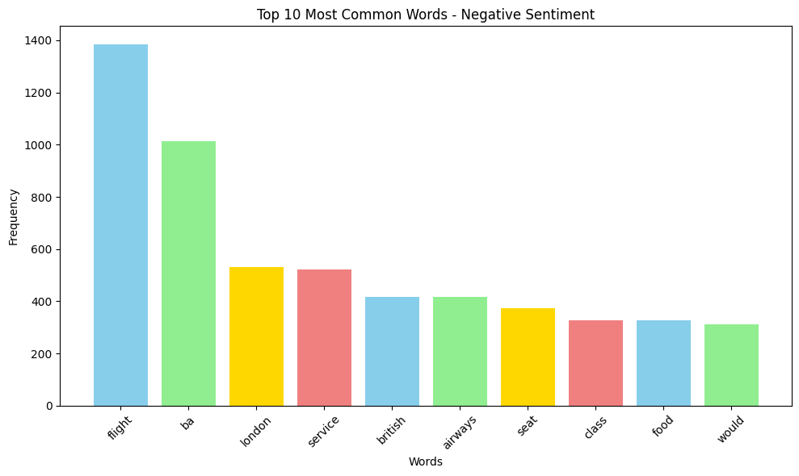
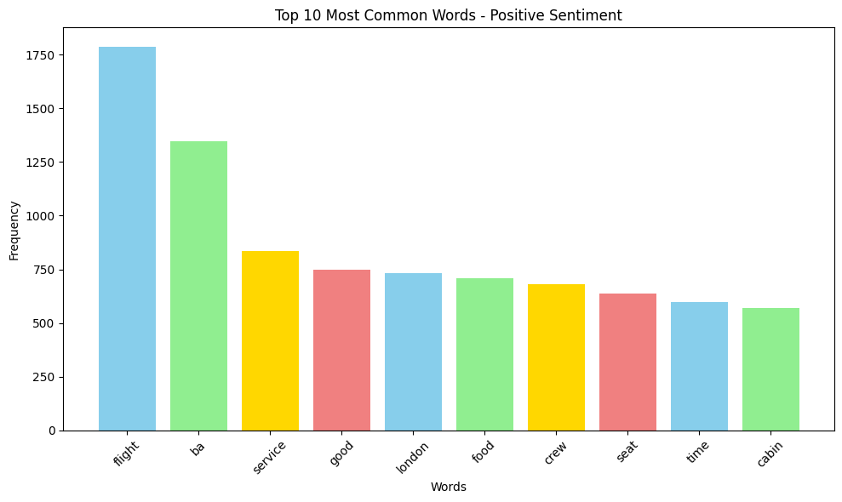
SOLELY FOR PURPOSES OF FORAGE WORK EXPERIENCE
Customer Review Sentiment Charts
Flight was the most used word across all sentiments
along with British airways(ba) ,service and london

